Slide 1
DragAndDrop
Parker zhou
parkerzho2010@gmail.com

Slide 2
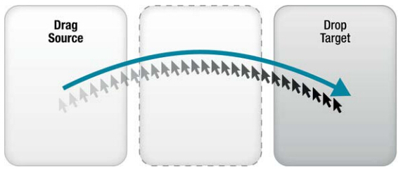
The Story So Far
Mouseout
Mousedown
Mousemove
Mouseover
Mousemove
Mouseover
Mouseup

Slide 3
Drag and Drop API
<li draggable=“true”>item1</li>

Slide 4
Drag and Drop API
<li draggable=“true”>item1</li>
1.dragstart
6.dragend
2.dragenter
<ul id="droplist">
</ul>
3.dragover
ev.dataTransfer
setData(key, data)
getData(key)
files
clearData()
setDragImage
4.dragleave
5.drop

Slide 5
File Drag and Drop
Drag and Drop files from operation system into browser view
Access file by File API in Html5

Slide 6
More about File API
FileList: iterate Files
Blob: raw data
size\type
slice
File: inherit from Blob,contains `name`
FileReader: asynchronously reads on Blob
http://www.w3.org/TR/FileAPI

Slide 7
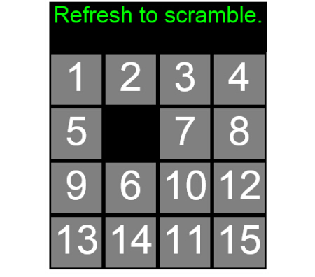
Exercise
Page 522
Notes:
Tips:
Use Math.random() to create a random sequence of numbers when initialized

